Slide 1
FACE MASK DETECTOR USING COMPUTER VISION AND DEEP LEARNING IN PYTHON

Slide 2
TEAM NAME: Champions
Team Members: | Phone Numbers
SWETHA S(LEADER) | 9384472153
RITHIKA S | 9361955458
SINDHU N R | 9986591666
SNEHA T | 6374925085
SOWMIYA S | 9353335714
DOMAIN: IMAGE PROCESSING
FACE MASK DETECTOR USING COMPUTER VISION AND DEEP LEARNING IN PYTHON

Slide 3
ABASTRACT:
The respiratory droplets and physical contact are the two main routes of transmission of the COVID-19 virus according to World Health Organization.
Medical masks are described in this study as surgical or procedure masks that are flat or pleated (some are shaped like cups); they are attached with straps to the head.
They are tested for controlled high filtration, proper breathability and optionally, resistance to fluid penetration.

Slide 4
TECHNOLOGICAL STACK:
PyTorch Device – identifies the running system capabilities
Pytorch TorchVision – it will help us to load the libraries which are created before
PyTorch nn – This module helps us to build our own Deep Neural Network (DNN) models.
PyTorch Optim – help us to define the model optimizer
Pytorch PIL – helps to load the image from the source
PyTorch AutoGrad – it provides automatic differentiation for all operations on Tensors
1.TensorFlow
2.Keras
3.PyTorch
4.Caffee
5.MxNet
6.Cognitive ToolKit from Microsoft
We use PyTorch since it runs on Python.
PyTorch DataLoader-used to load information from the Image Folder
The PyTorch DataSets ImageFolder is used to locate image sources
Pytorch Transforms, when reading from the source folder.

Slide 5
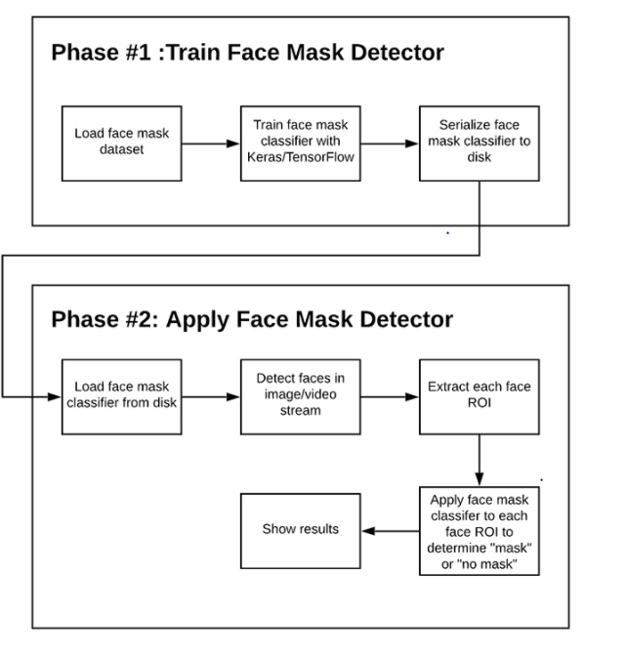
Two-phase COVID-19 face mask detector
SOFTWARE IMPLEMENTATION:

Slide 6
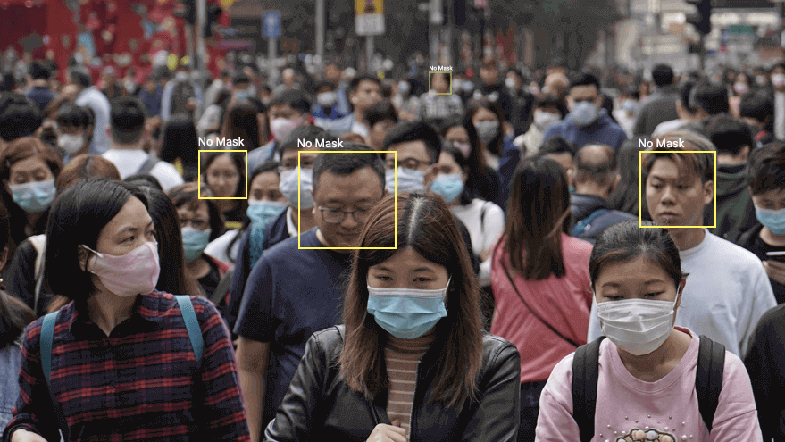
BUSINESS SCOPE:
Airports
Hospitals
Workplaces
Government buildings.

Slide 7
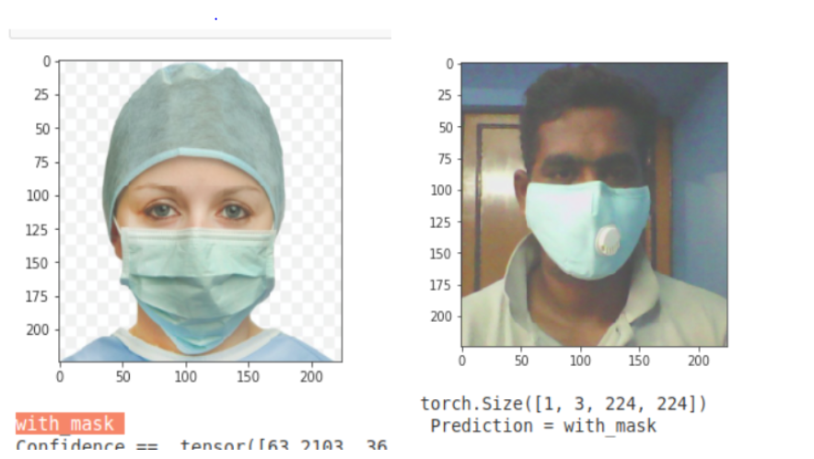

CONCLUSION:
The accuracy of the model is around 60%, the optimization of the model is a continuous process.MobileNetV2 was used to build the mobile version of the same. This specific model could be used as a use case for edge analytics.
Ideas2It -https://www.ideas2it.com/blogs/face-mask-detector-using-deep-learning-pytorch-and-computer-vision-opencv/
Real-Time Face Mask Detector with Python, OpenCV, Keras
pyimgsearch-COVID 19 face detector using open CV
github chandrikadeb-face mask detection

Slide 8
THANKYOU

